Slide 1
Video Processing System Based On Neural Network That Performs The Color Detection
Team Members:
Ushasri Badinidi
Rohini Panikara
Prasanth Rayudu
Shaik Shaheed Basha
Namrata Yadav

Slide 2
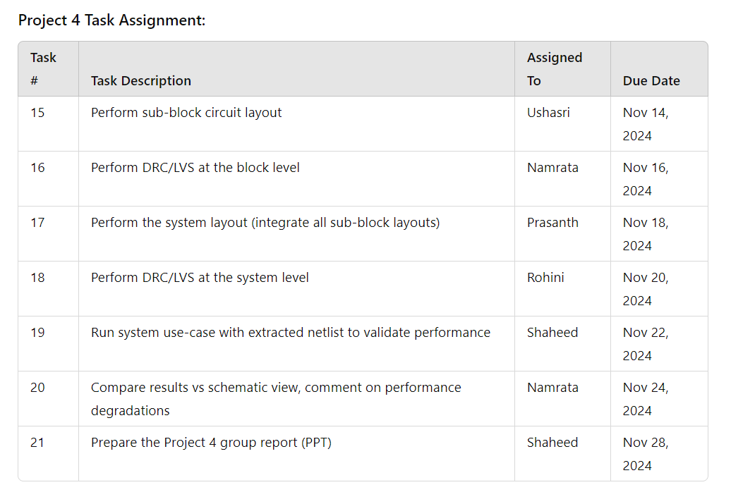

Slide 3
Tasks List
S.No | Task | Status | Contributed by
1 | Adder Transistor level Schematic,Validation | Finished | Namrata
2 | Multiplier Transistor level Schematic,Validation | Finished | Prashanth
3 | Rom Schematic | Finished | Ushasri
4 | Color Mapping Block Transistor level Schematic,Validation | Finished | Shaheed
5 | Comparing results vs Schematic and View | Finished | Rohini
7 | Project 3 report | Finished | Shaheed

Slide 4
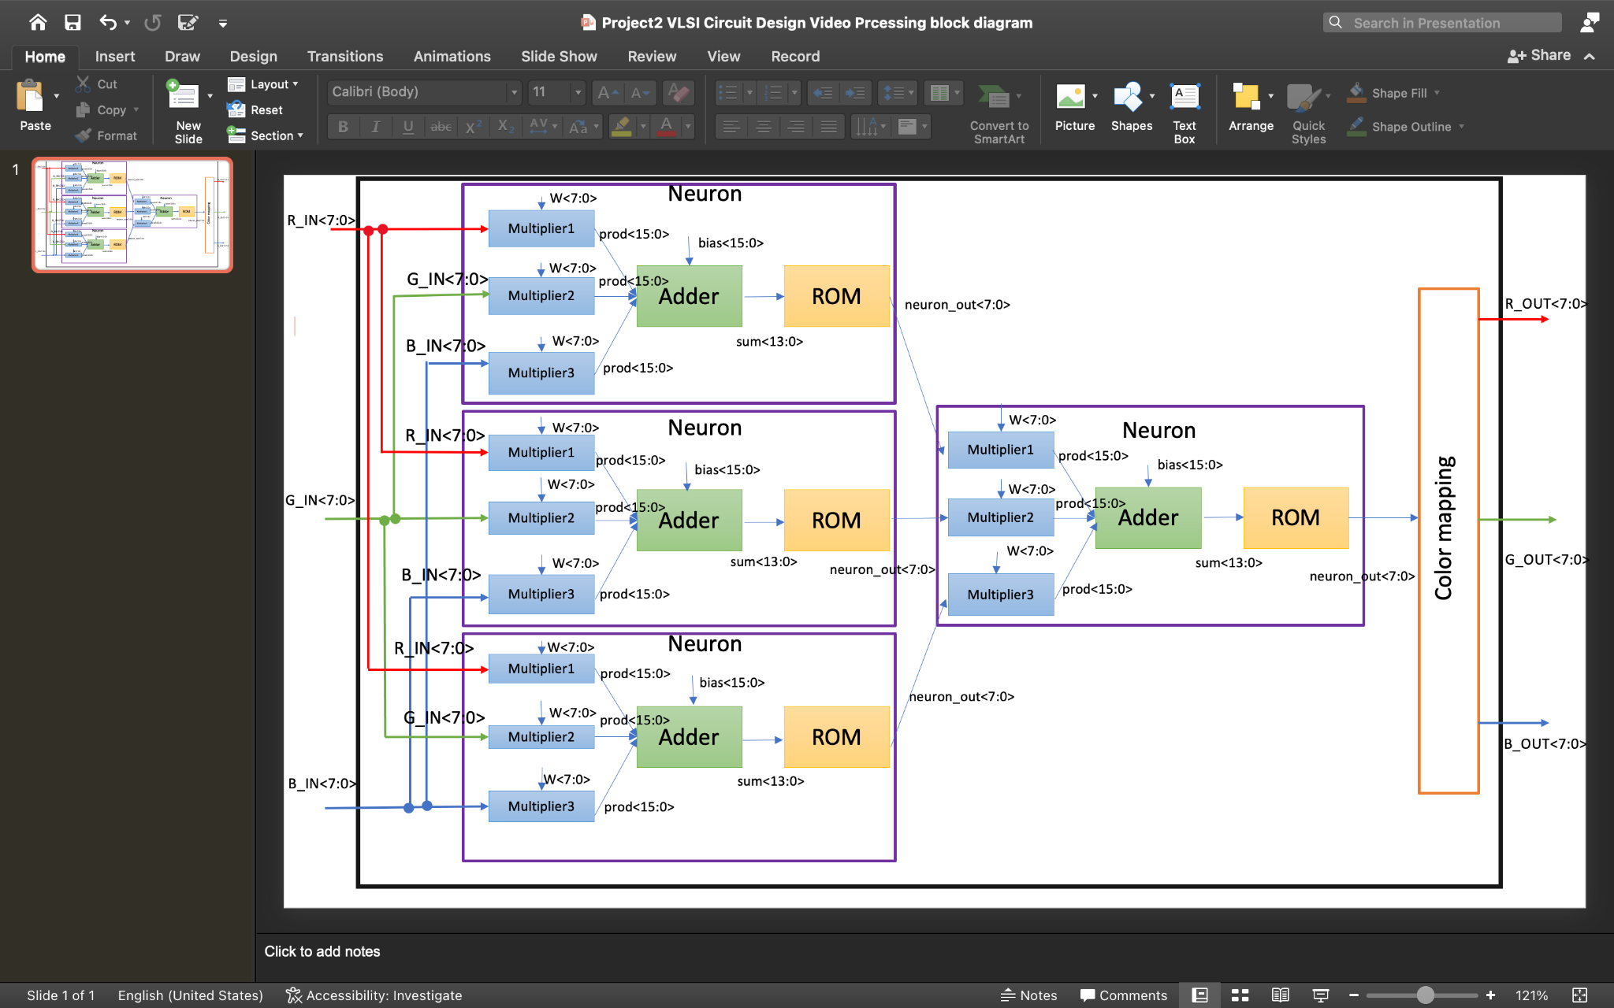
Block Diagram
Video Processing

Slide 5
Objective:
The primary objective of this project is to design, implement, and validate a high-performance system through the following stages:
Sub-block Circuit Layout: Create accurate layouts for individual sub-blocks, ensuring adherence to design constraints.
Block-Level Verification: Perform Design Rule Checks (DRC) and Layout vs. Schematic (LVS) validation to confirm the accuracy of individual sub-block layouts.
System Integration: Integrate all sub-block layouts into a cohesive system layout while maintaining design hierarchy and functionality.
System-Level Verification: Conduct DRC/LVS at the system level to ensure compliance with foundry rules and consistency with the schematic.
Post-Layout Simulation: Validate system performance by running use-case simulations on the extracted netlist, ensuring tapeout-readiness.
Performance Analysis: Compare post-layout simulation results with schematic-level results to identify and analyze performance degradations.
Final Specification Review: Summarize the design’s final specifications, highlighting key performance metrics, compliance with design requirements, and any trade-offs.

Slide 6
Verification and Validation Overview
Blocks Under Verification:
Adder Block
Multiplier Block
Color Mapping Block
Verification Tasks Performed:
Layout Design:
Developed accurate circuit layouts for all blocks following design constraints and foundry rules.
DRC (Design Rule Check):
Ensured all block layouts comply with manufacturing design rules for tapeout readiness.
LVS (Layout vs. Schematic):
Verified that the physical layout matches the intended schematic functionality.

Slide 7
Adder Schematic
Adder schematic consists of:
AND
OR
XOR
HALF ADDER
FULL ADDER
ADDER

Slide 8
Multiplier Schematic
Multiplier schematic consists of
AND
OR
XOR
Half adder
Full adder
MUX

Slide 9
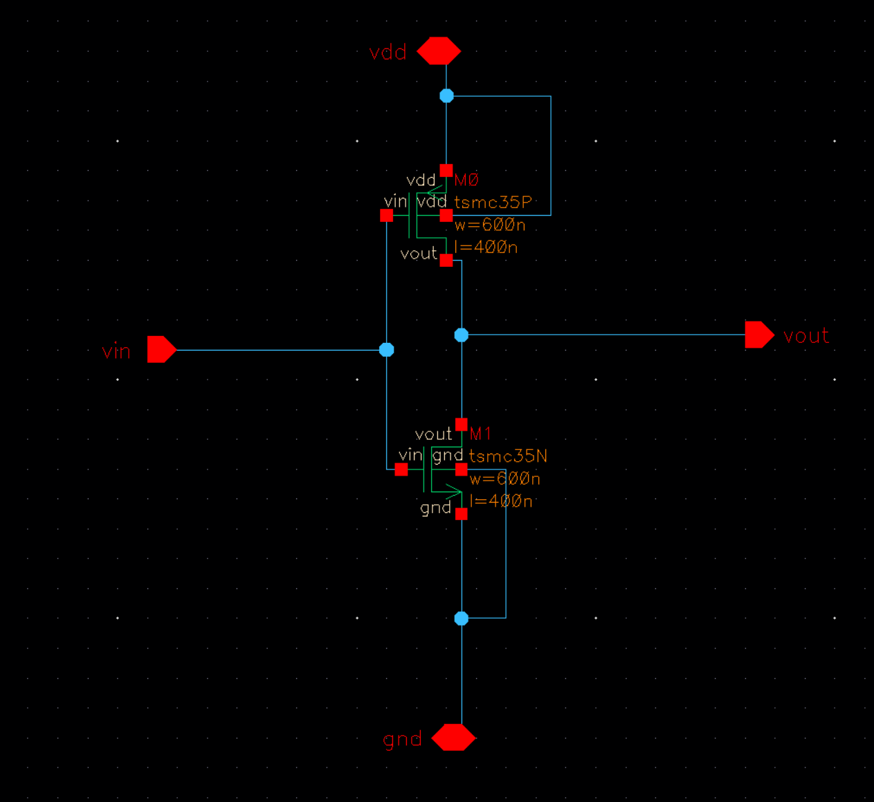
INVERTER Schematic

Slide 10
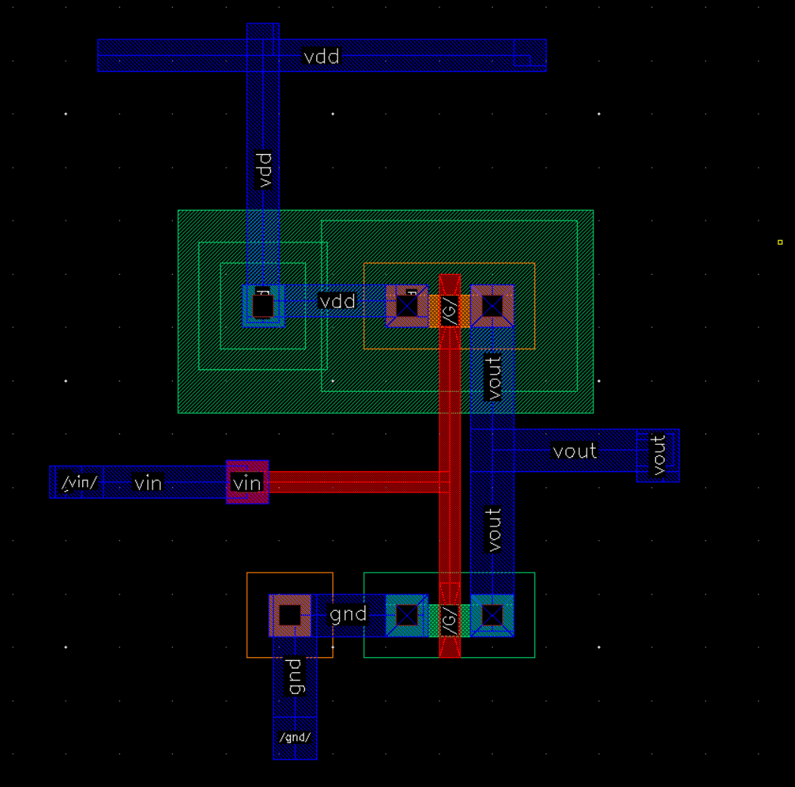
INVERTER LAYOUT

Slide 11
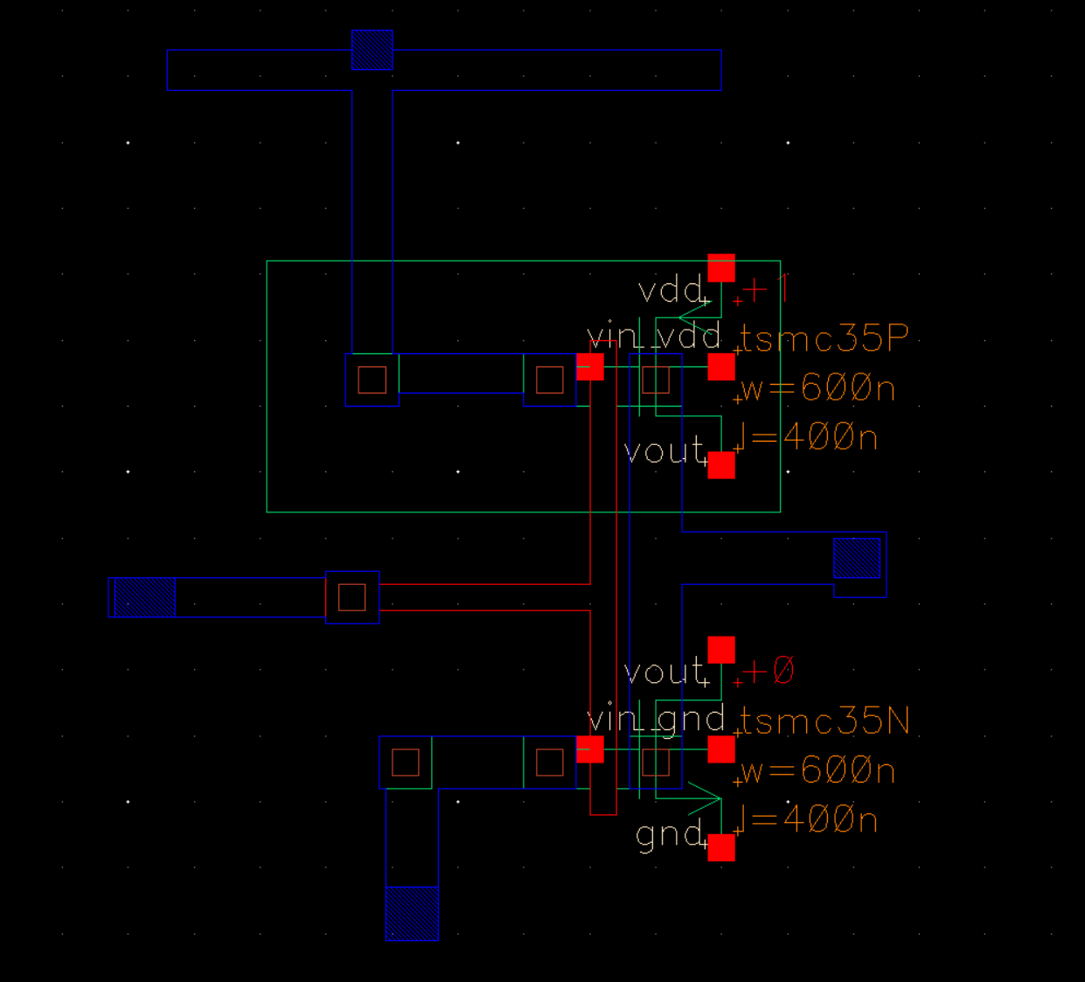
INVERTER EXTRACTED

Slide 12
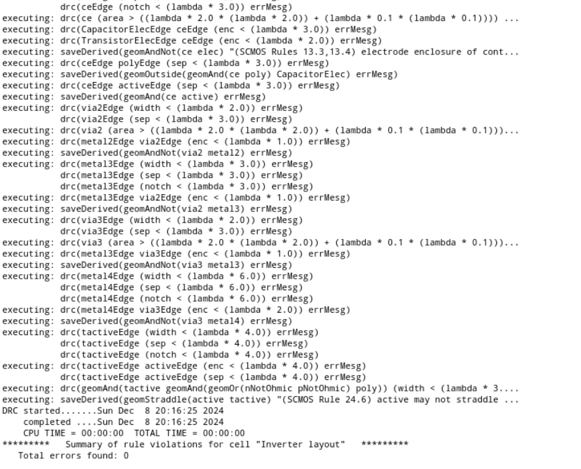
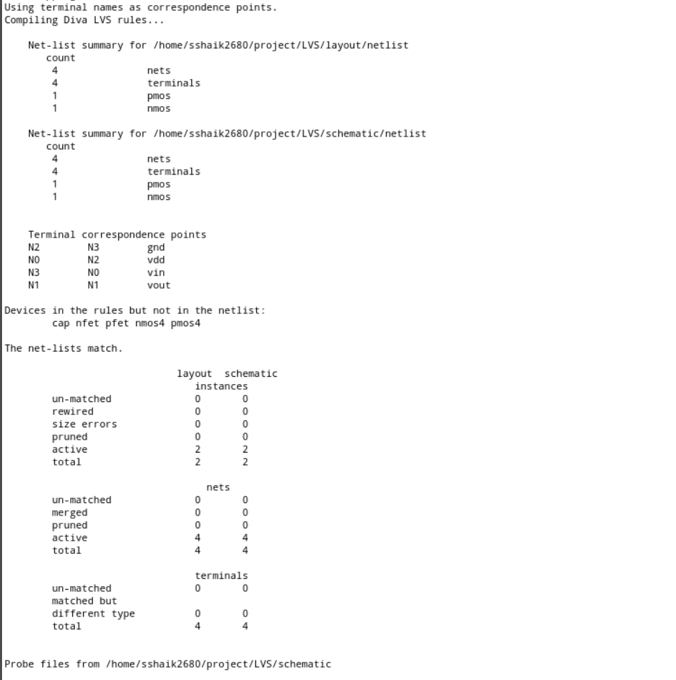
INVERTER VERIFICATION

Slide 13
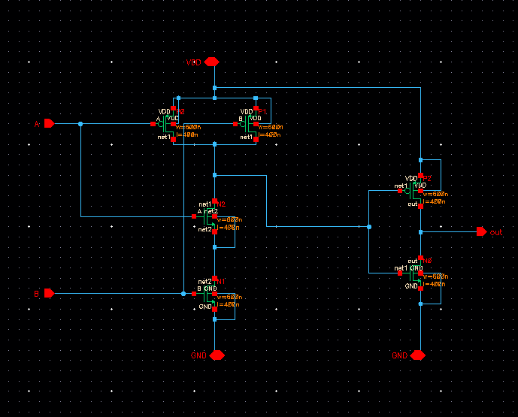
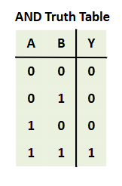
AND Block Schematic

Slide 14
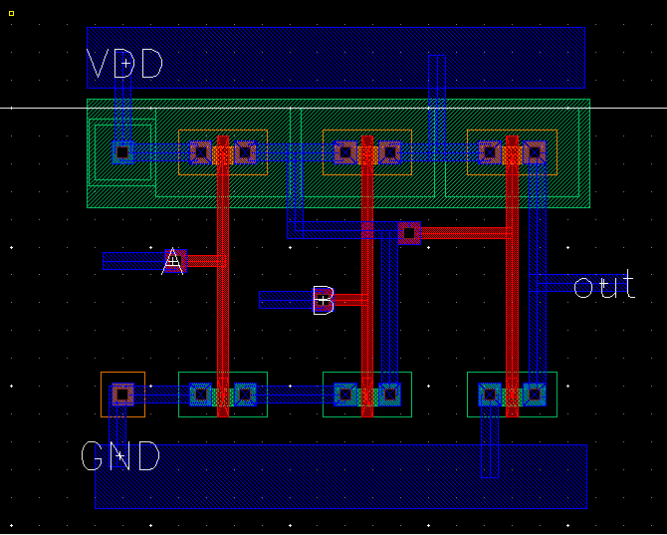
AND LAYOUT

Slide 15
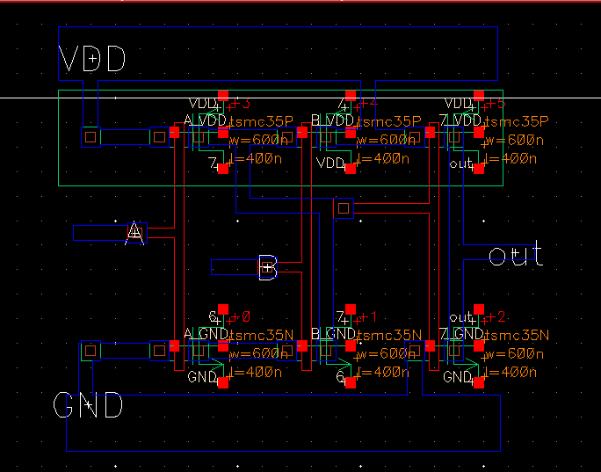
AND EXTRACTED

Slide 16
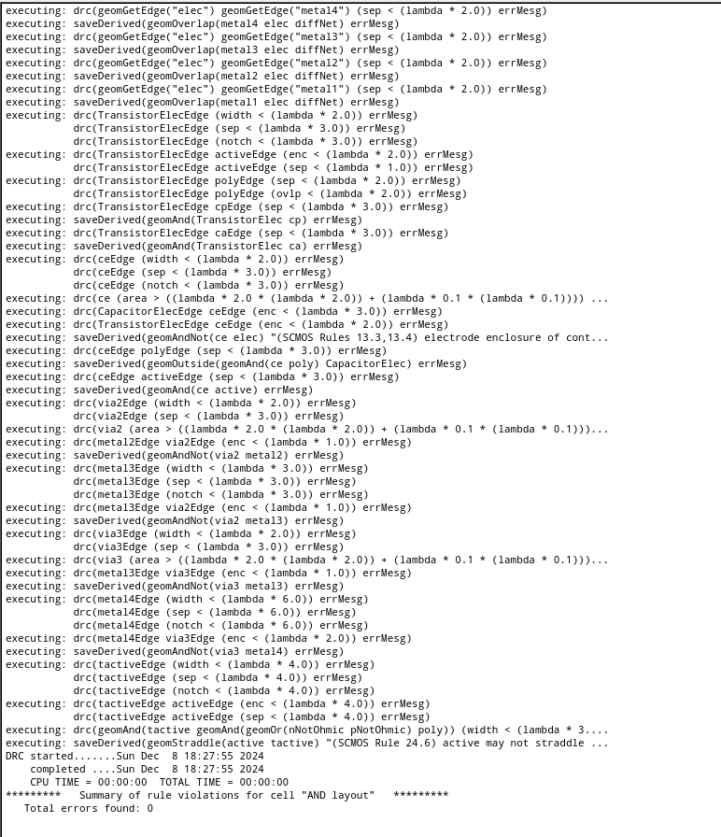
AND VERIFICATION

Slide 17
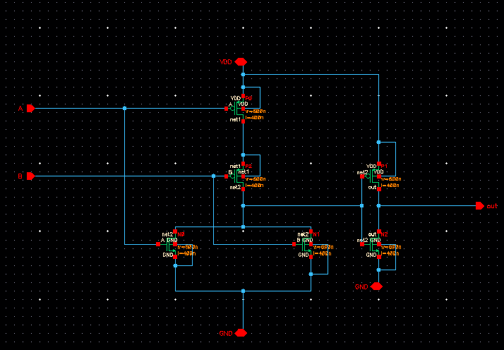
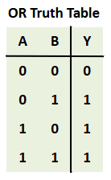
OR Schematic

Slide 18
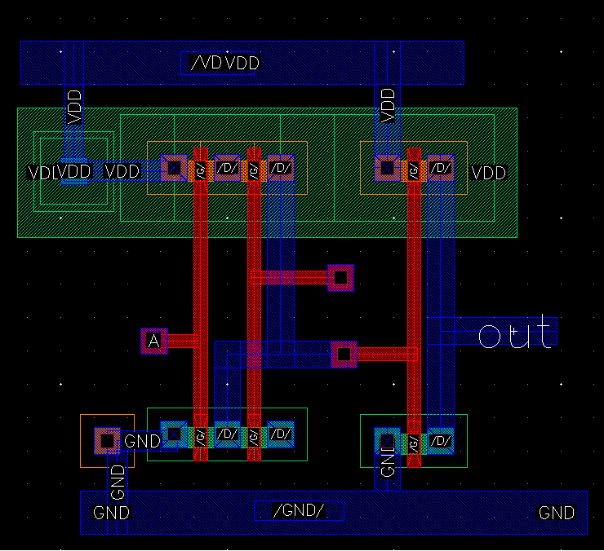
OR LAYOUT

Slide 19
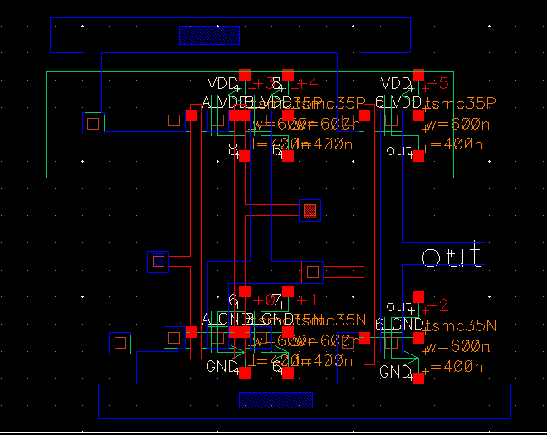
OR EXTRACTED

Slide 20
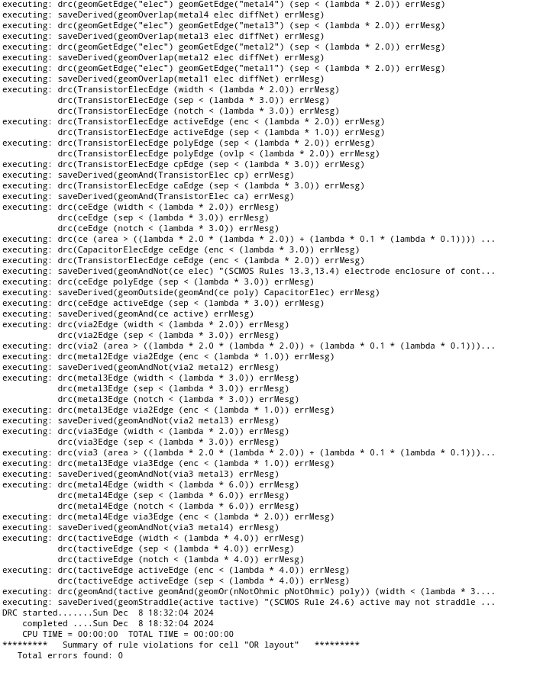
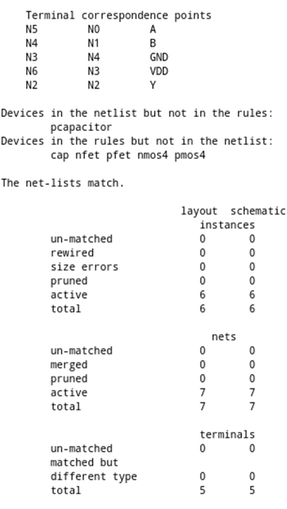
OR VERIFICATION

Slide 21
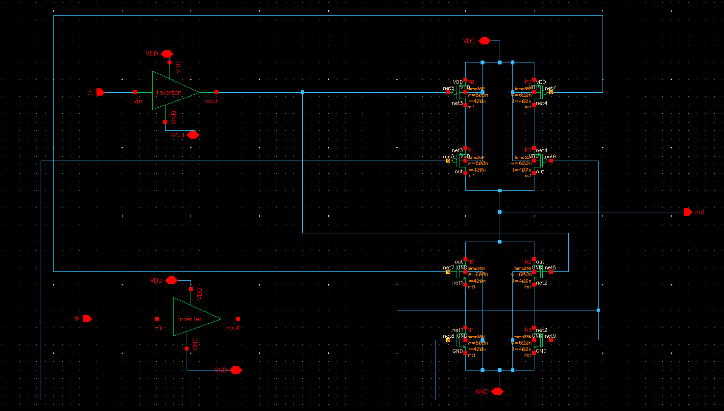
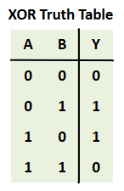
XOR Schematic

Slide 22
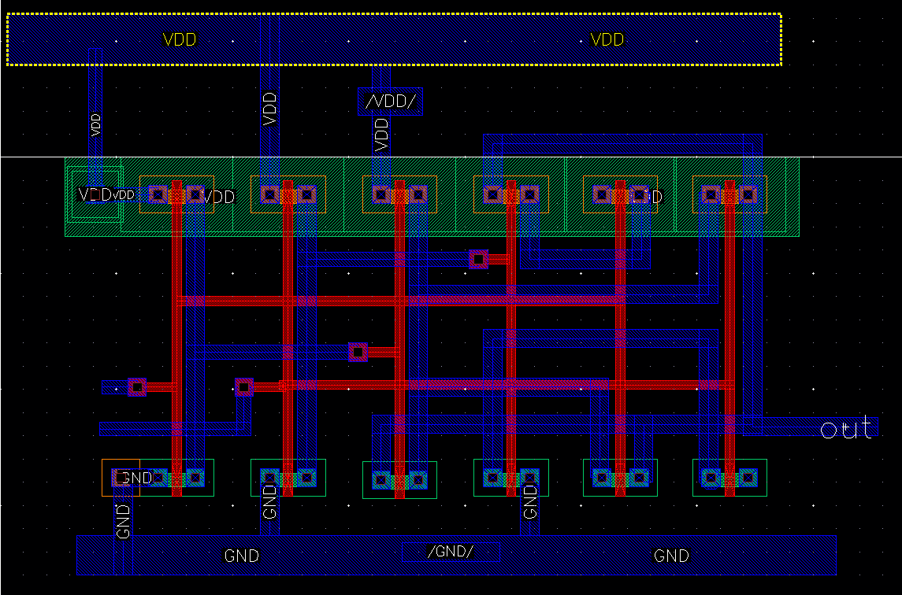
XOR LAYOUT

Slide 23
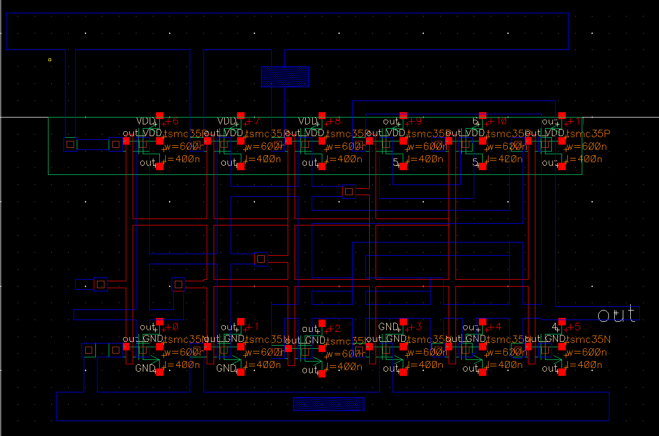
XOR EXTRACTED

Slide 24
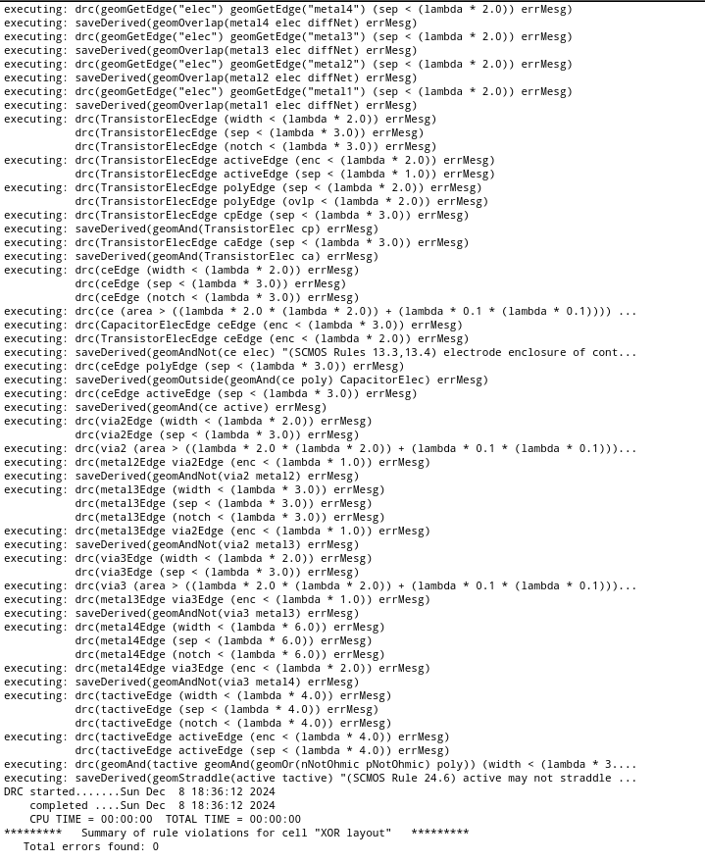
XOR VERIFICATION

Slide 25
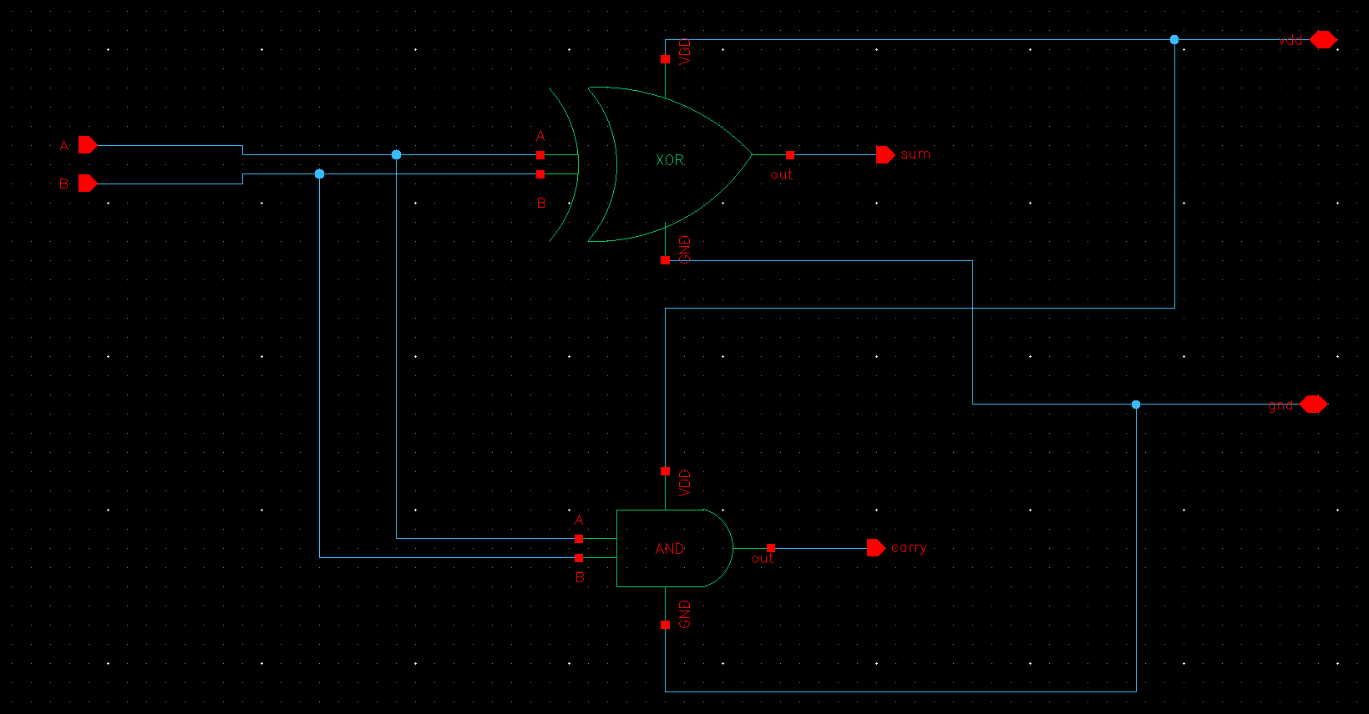
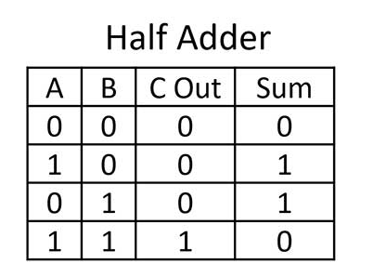
HALF ADDER Schematic

Slide 26
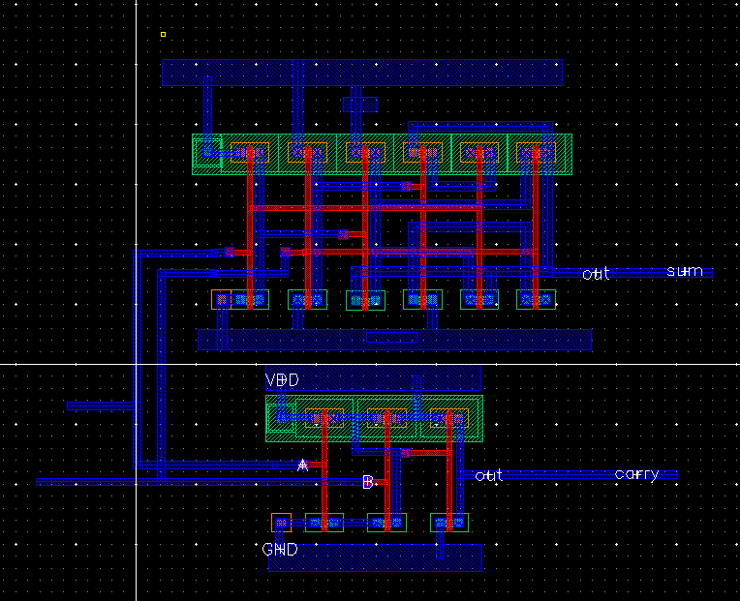
HALF ADDER LAYOUT

Slide 27
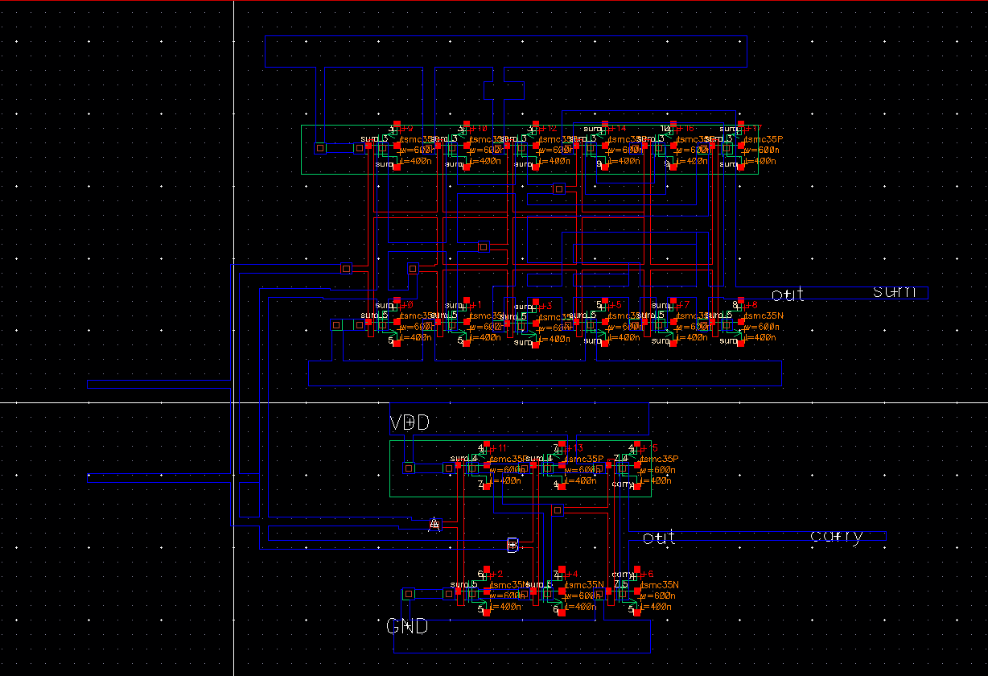
HALF ADDER EXTRACTED

Slide 28
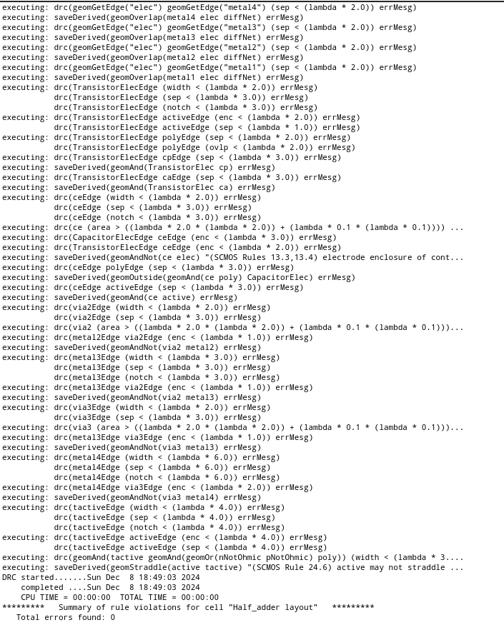
HALF ADDER VERIFICATION

Slide 29
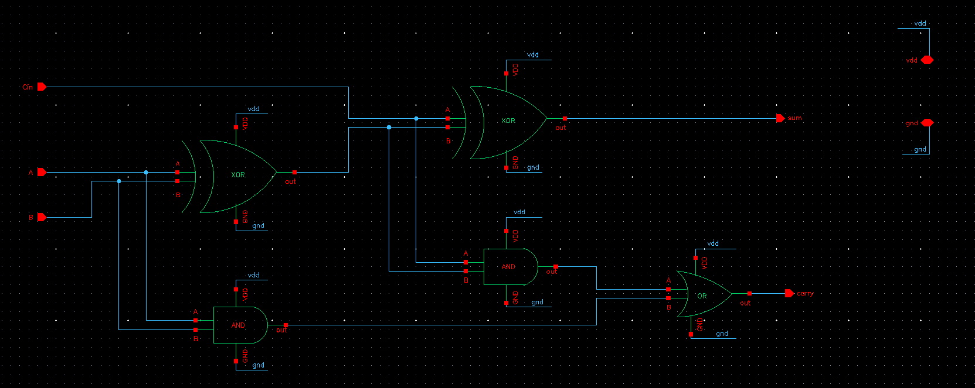
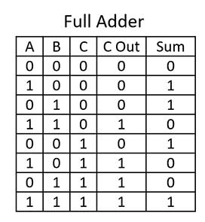
FULL ADDER Schematic

Slide 30
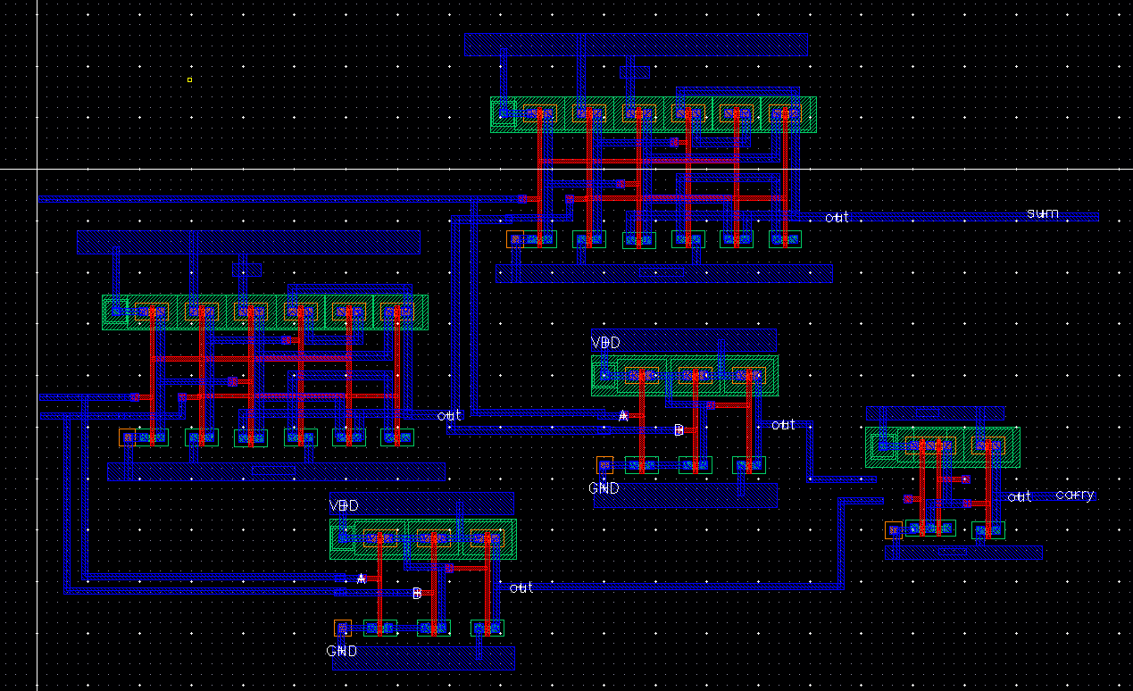
FULL ADDER LAYOUT

Slide 31
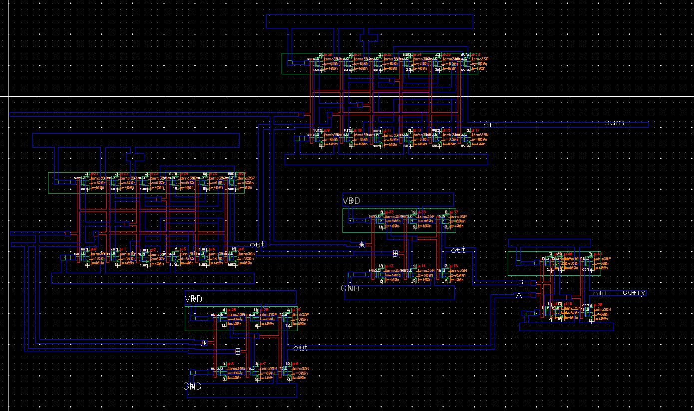
FULL ADDER EXTRACTED

Slide 32
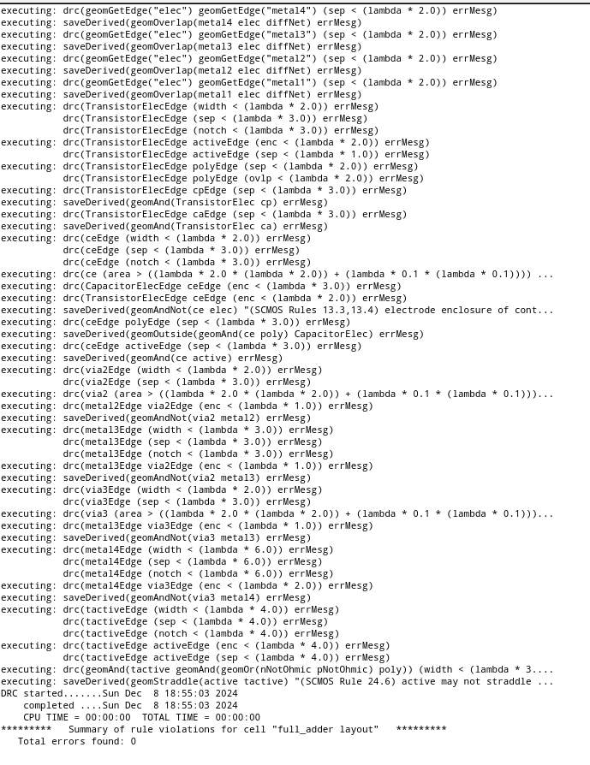
FULL ADDER VERIFICATION

Slide 33
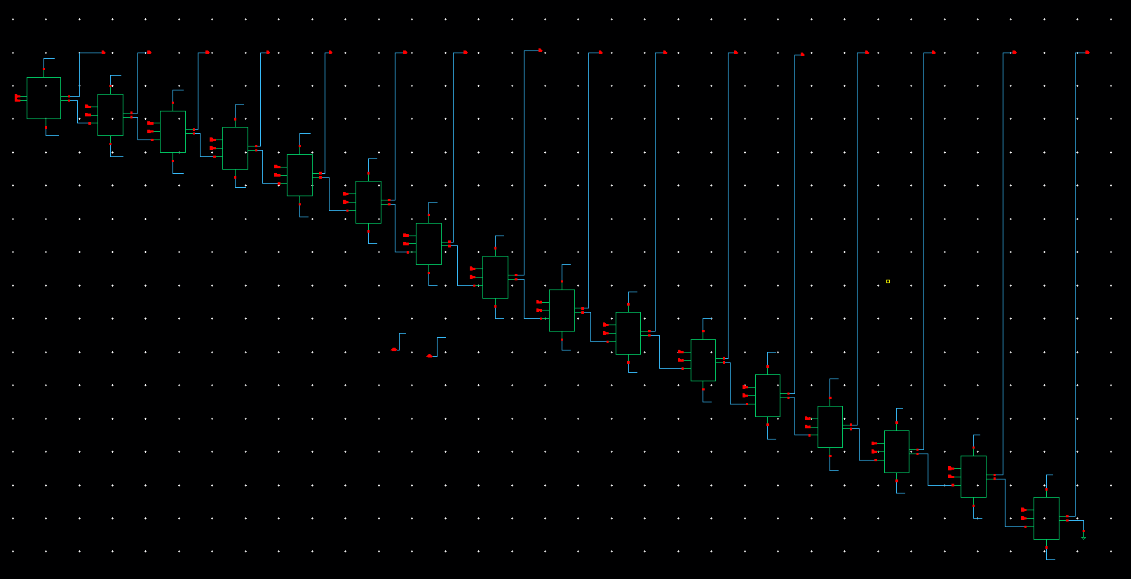
ADDER BLOCK Schematic

Slide 34
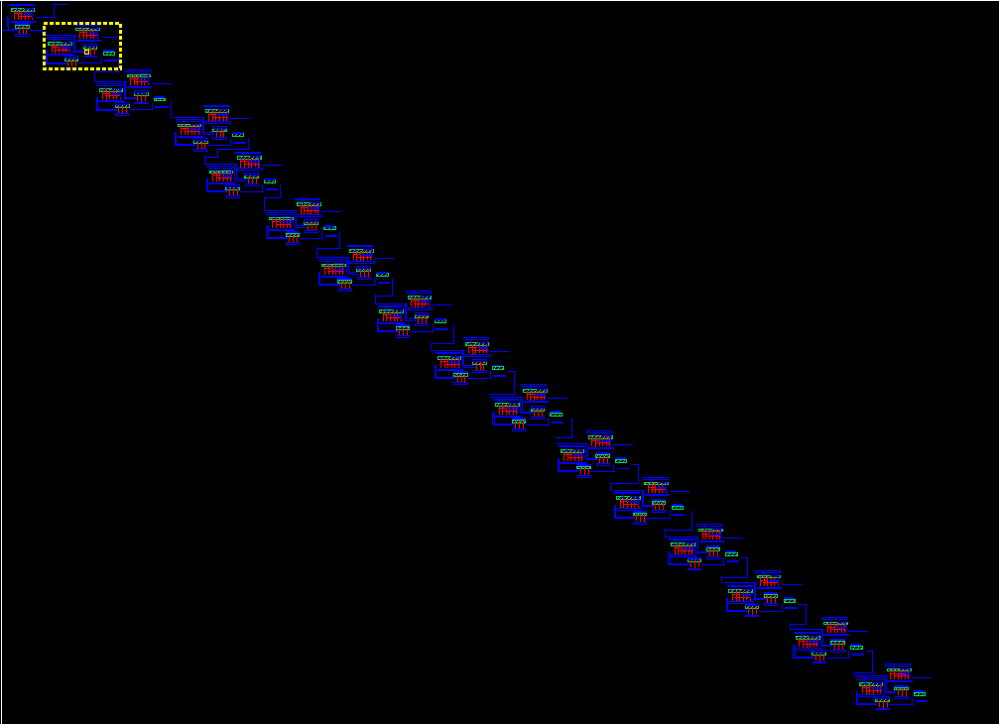
ADDER LAYOUT

Slide 35
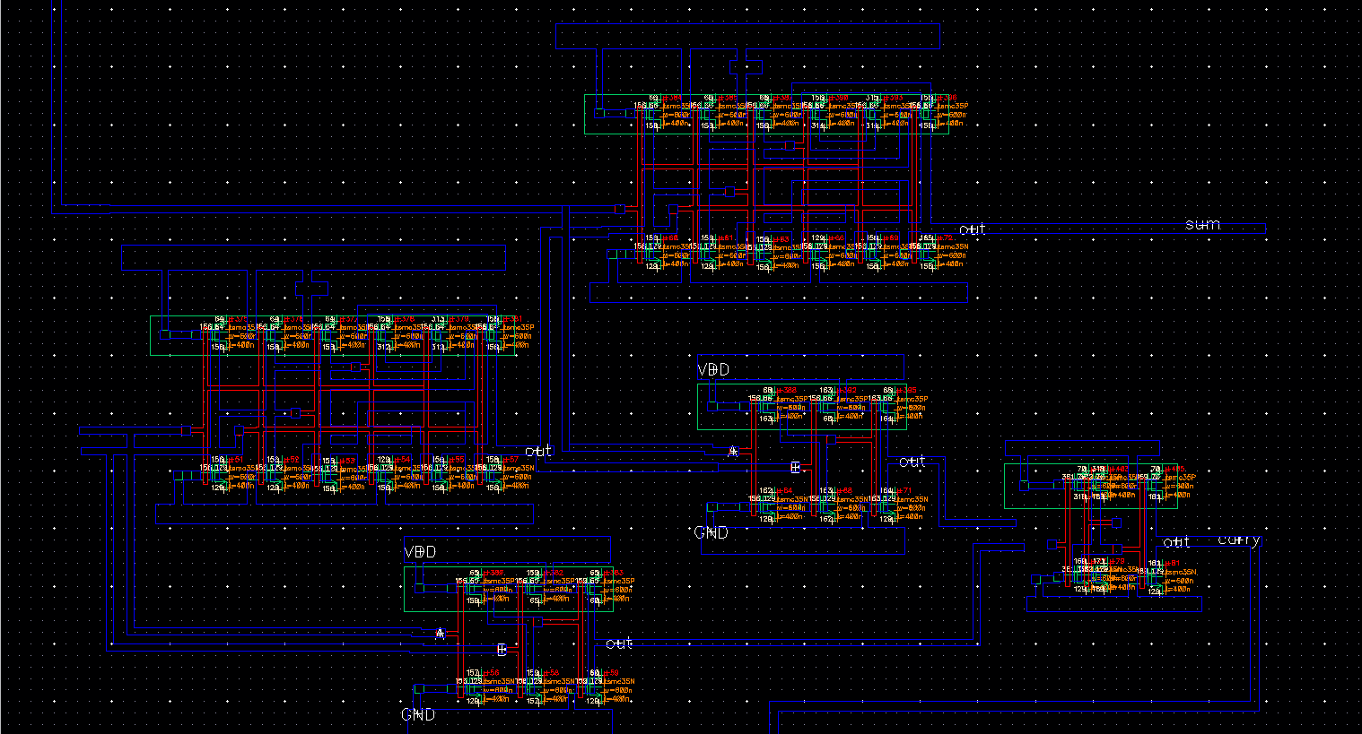
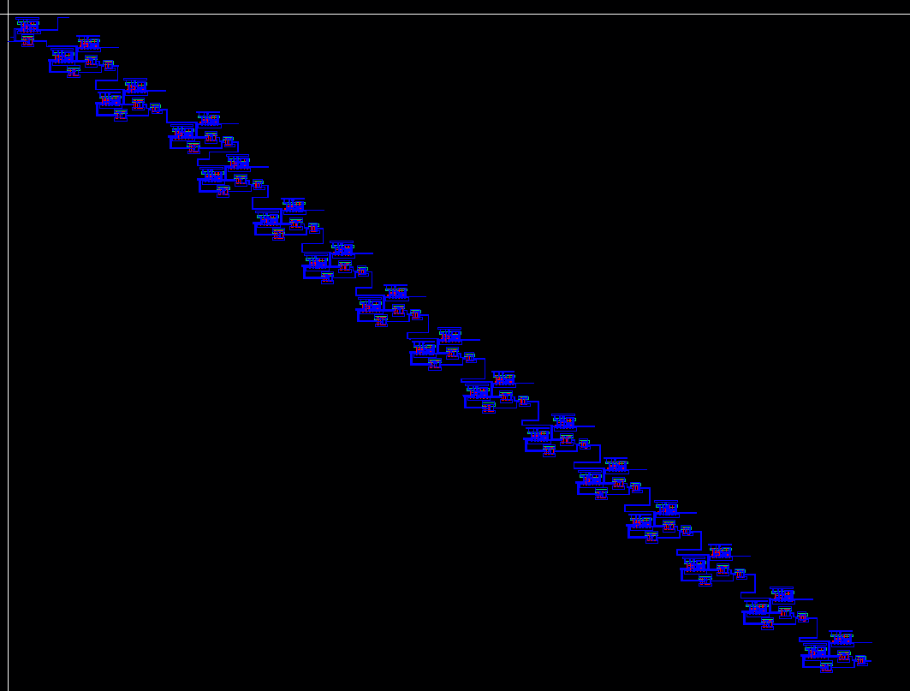
ADDER EXTRACTED

Slide 36
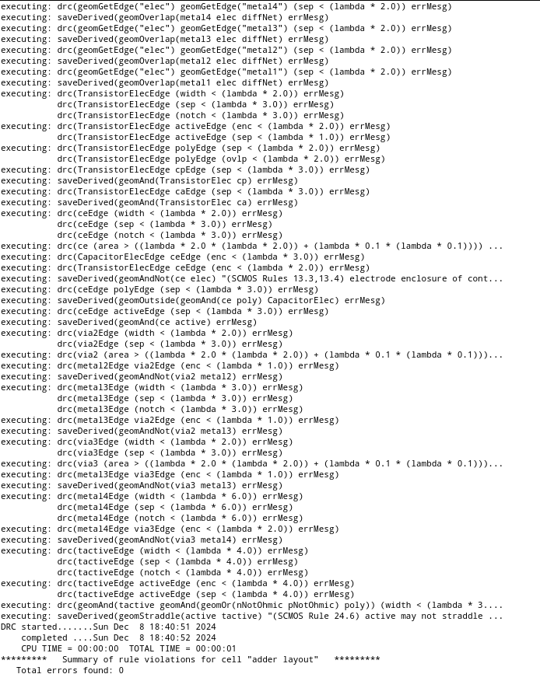
ADDER VERIFICATION

Slide 37
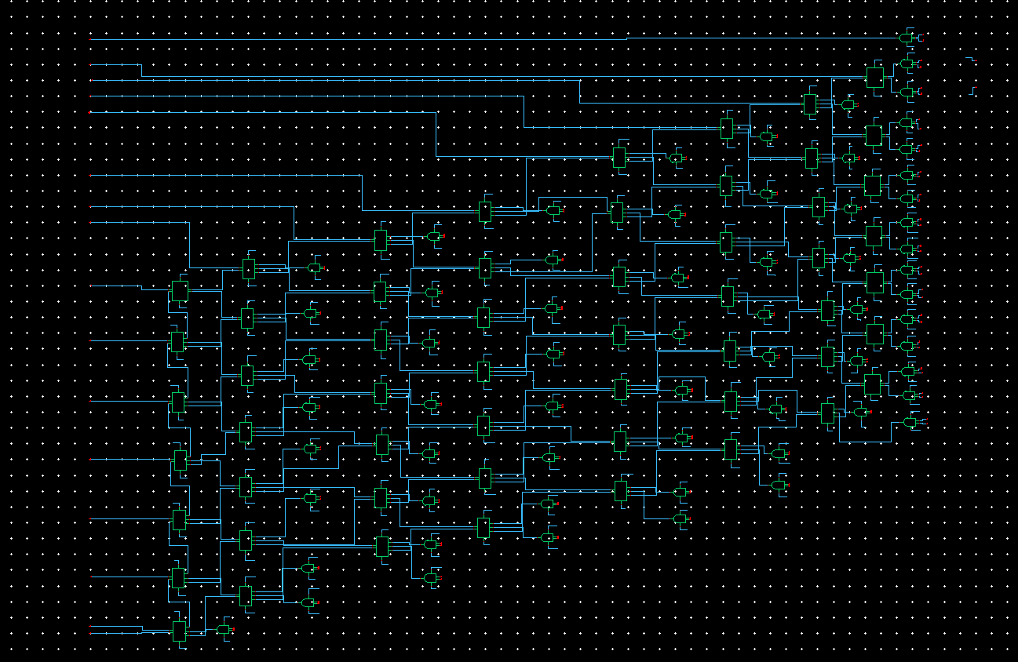
MULTIPLIER Schematic

Slide 38
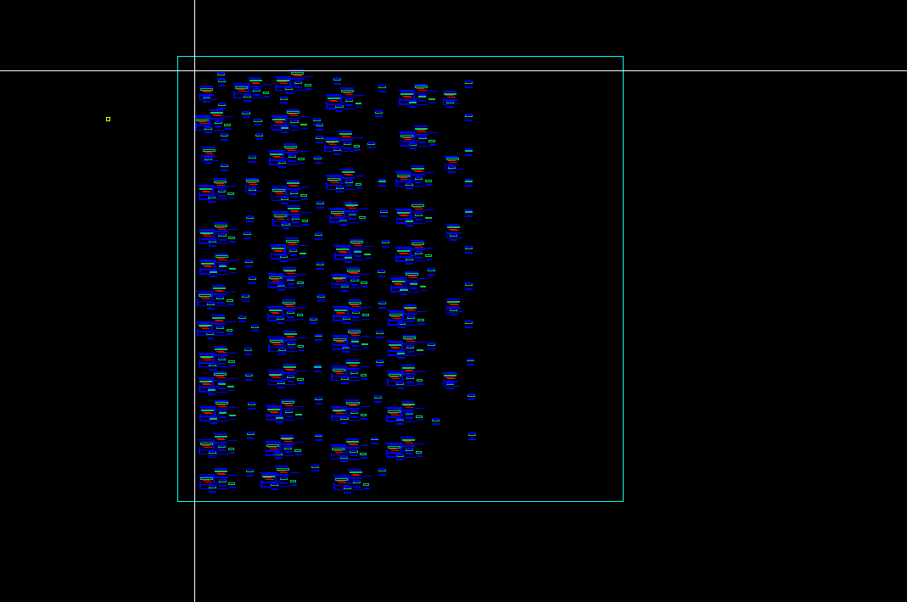
MULTIPLIER LAYOUT

Slide 39
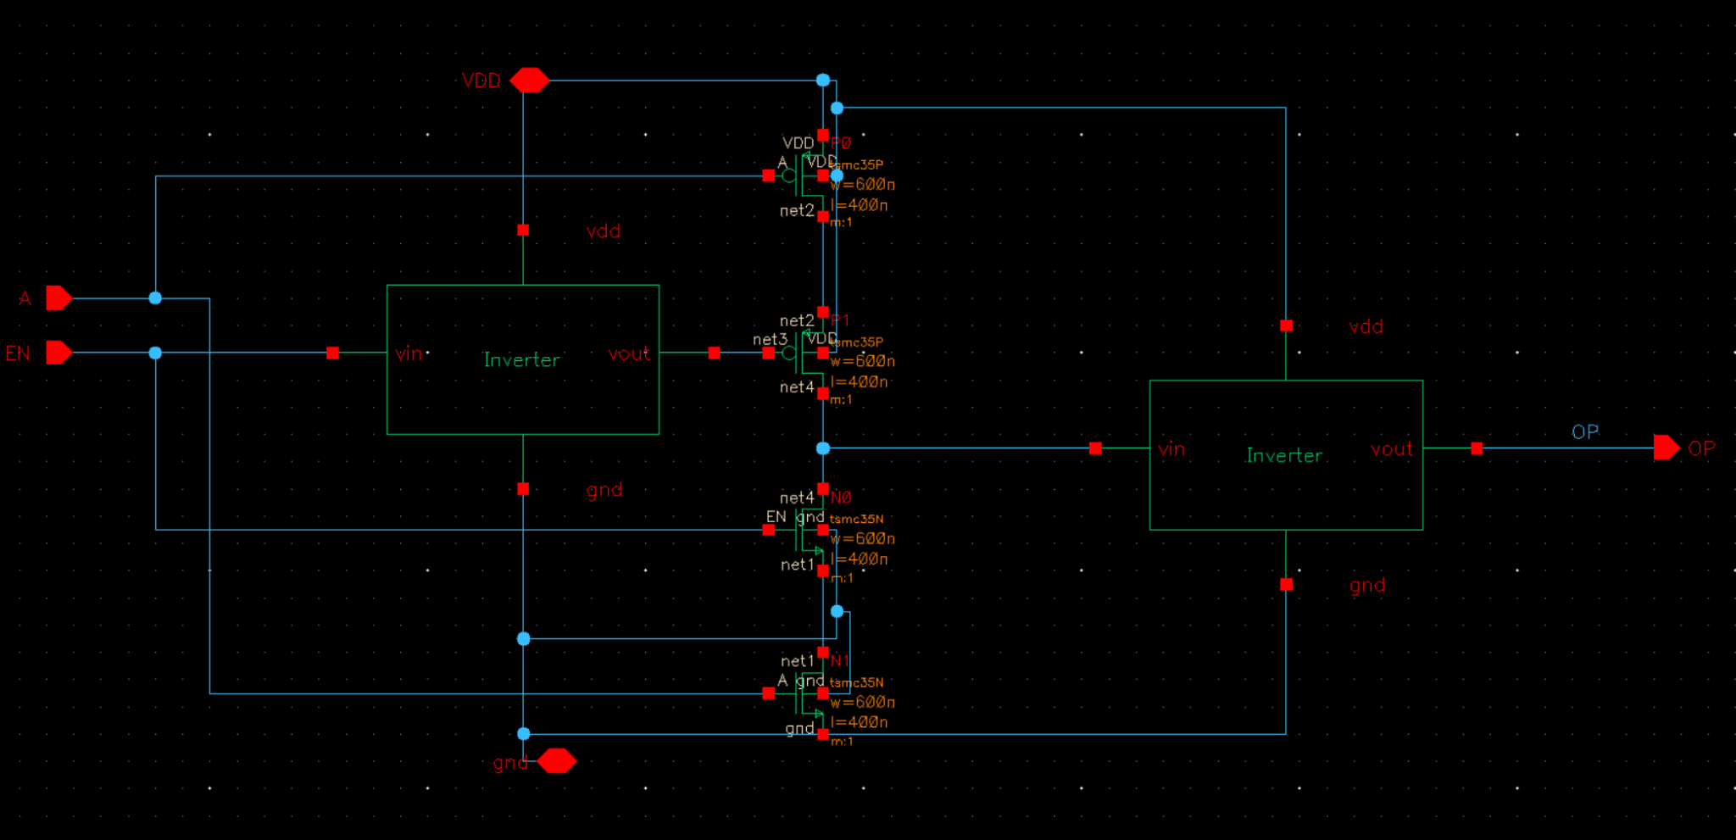
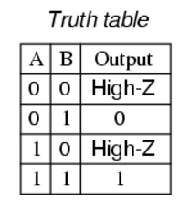
TRI STATE BLOCK SCHEMATIC

Slide 40
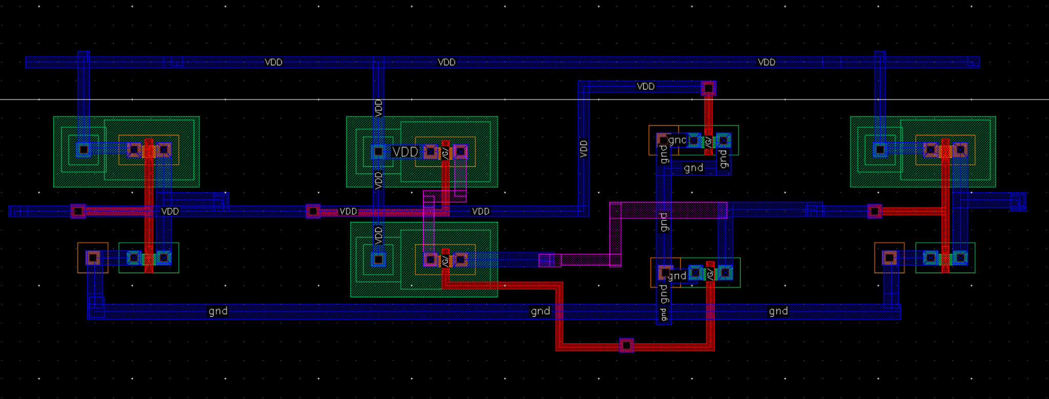
TRI STATE LAYOUT

Slide 41
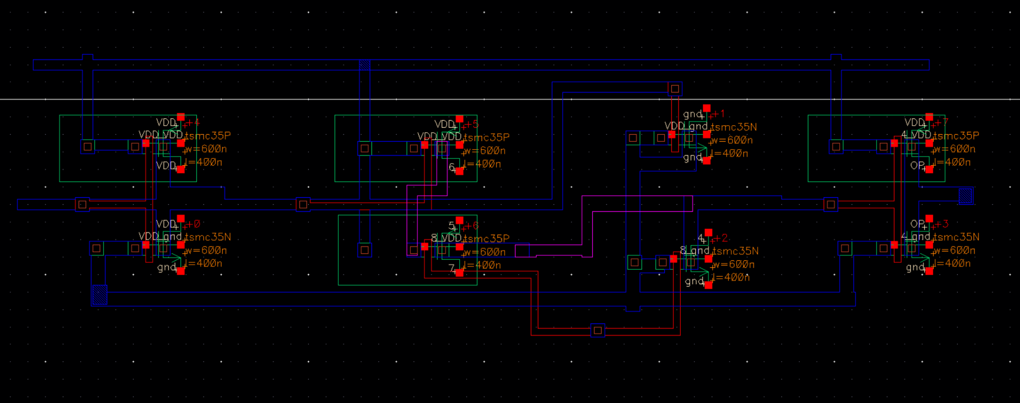
TRI-STATE EXTRACTED

Slide 42
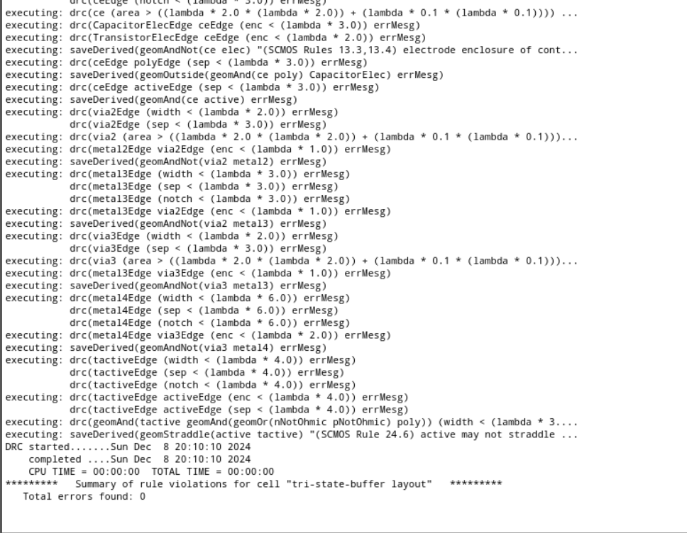
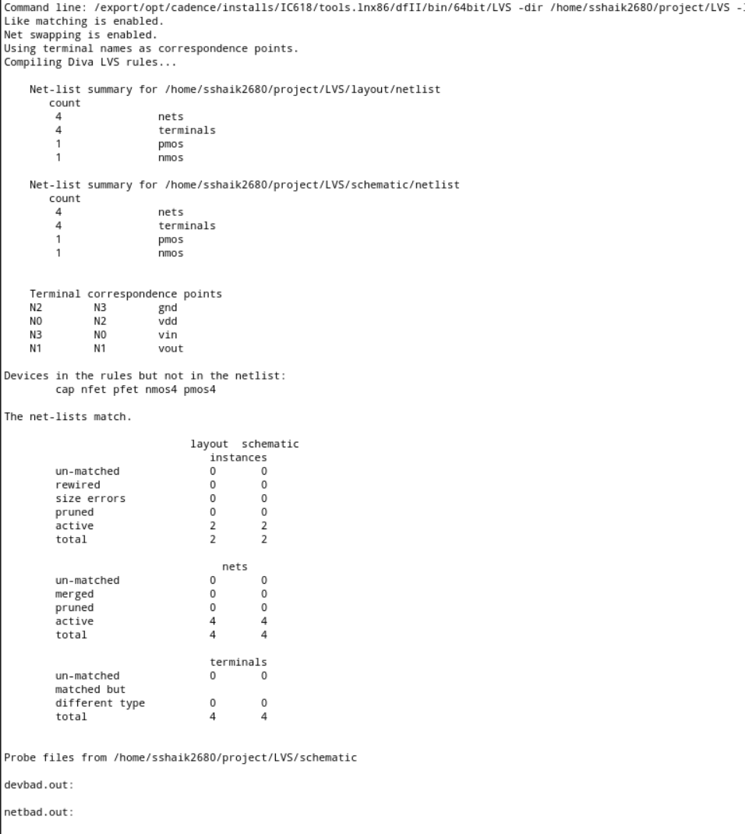
TRI-STATE VERIFICATION

Slide 43
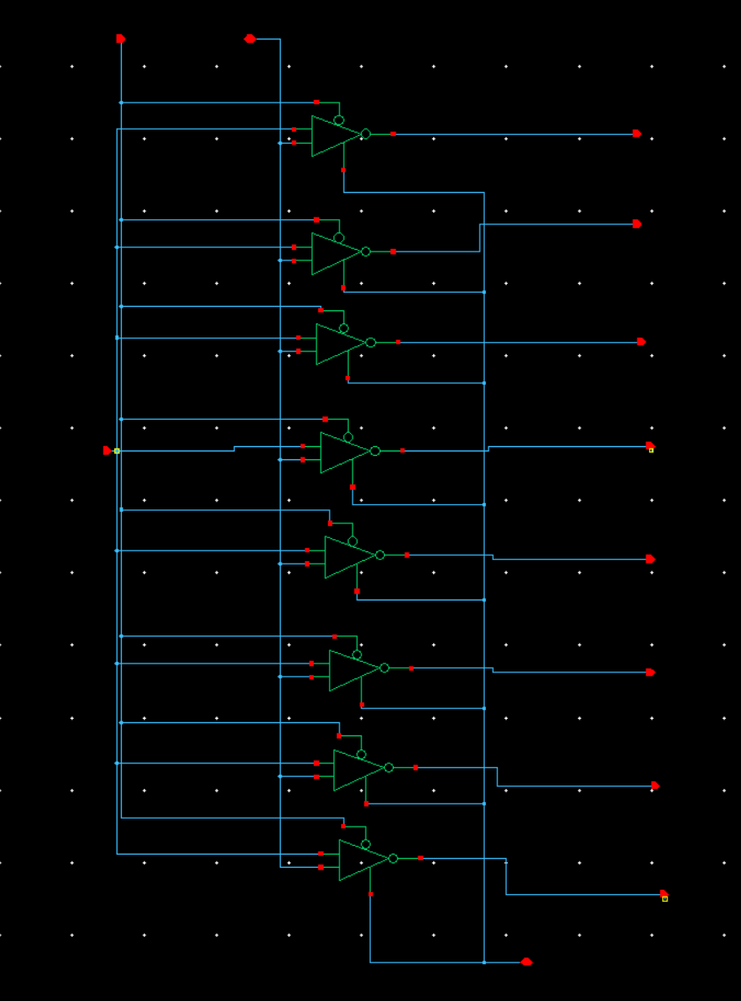
SINGLE COLOR OUTPUT SCHEMATIC

Slide 44
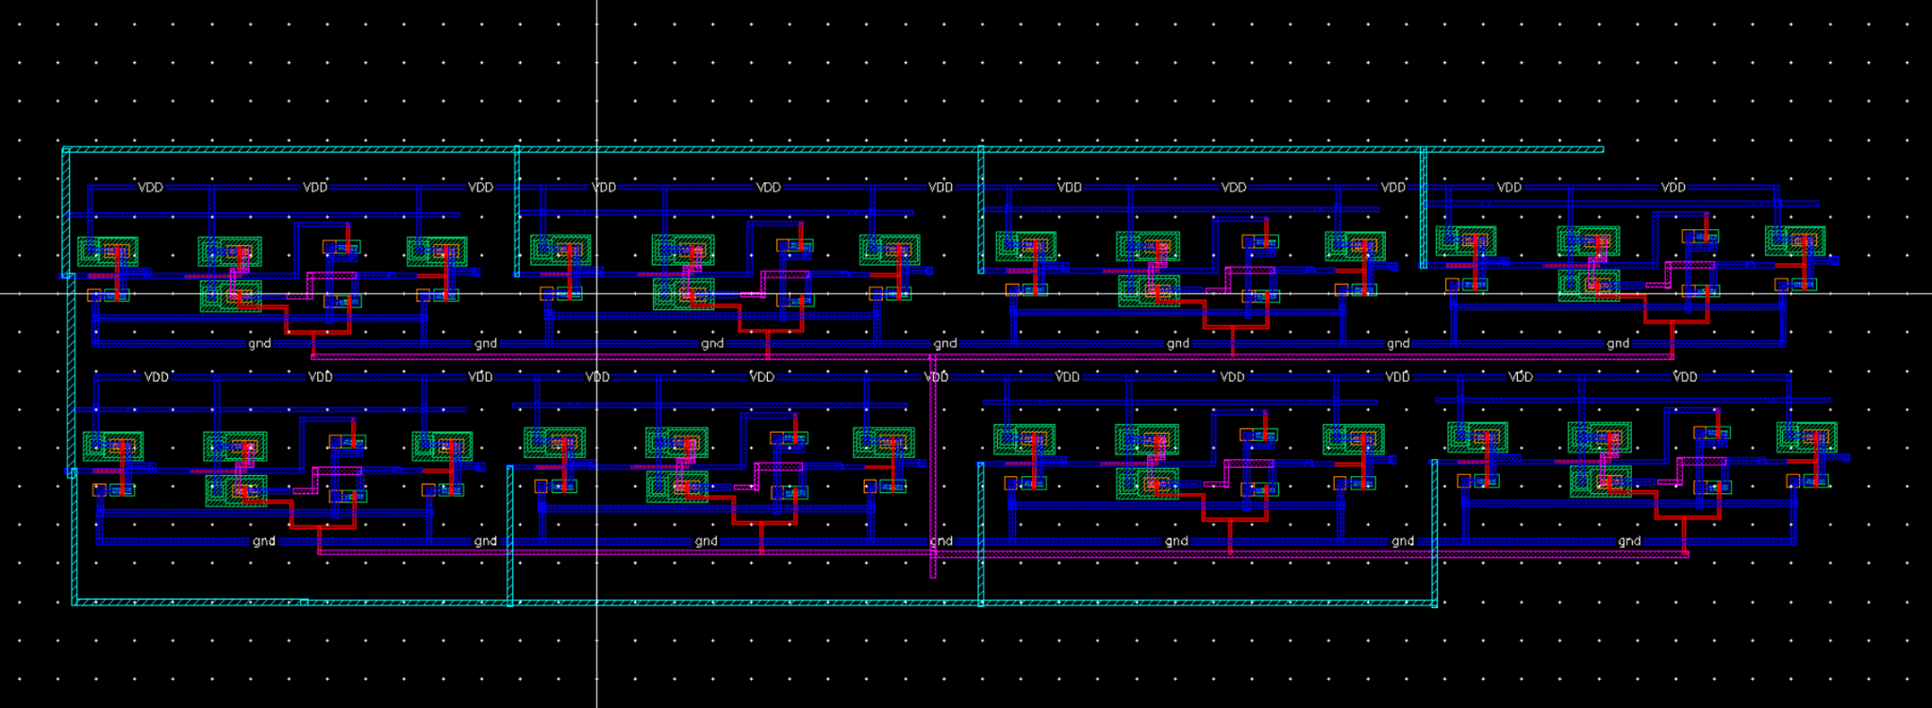
SINGLE COLOR OUTPUT LAYOUT

Slide 45
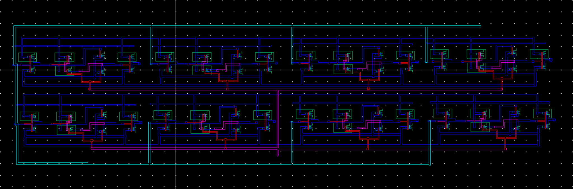
SINGLE COLOR OUTPUT EXTRACTED

Slide 46
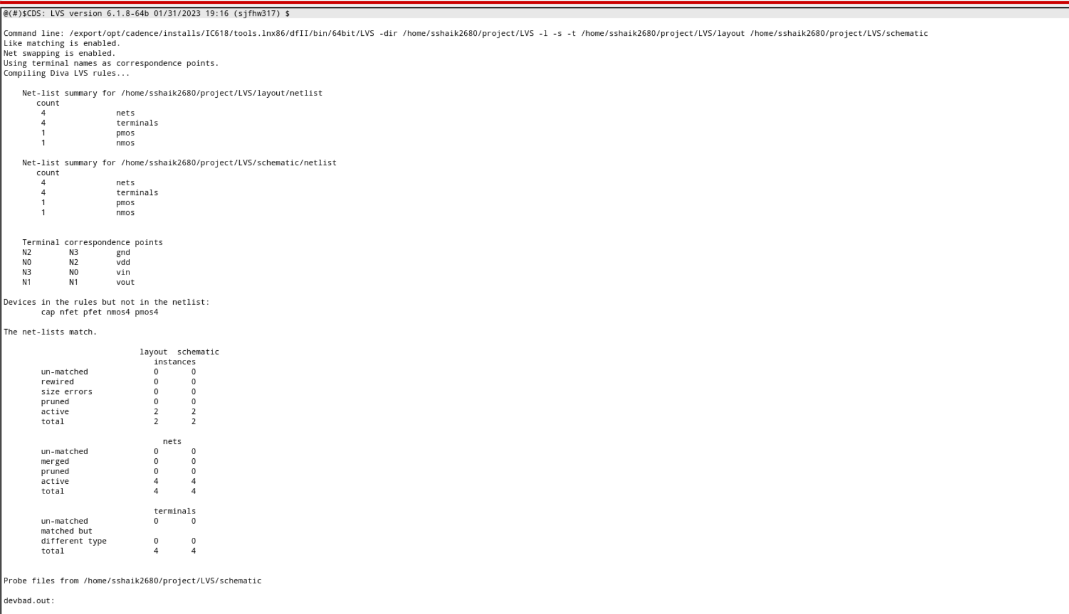
SINGLE COLOR OUTPUT VERIFICATION

Slide 47

COLOR DETECTION BLOCK SCHEMATIC

Slide 48

COLOR DETECTION BLOCK LAYOUT

Slide 49

COLOR DETECTION BLOCK EXTRACTED

Slide 50

ROM Layout As Black Box
For layout ROM is implemented as square black box with length=3620.38nm² and width=3620.38nm²
to fit in estimated area of 13107200 nm²=13.1µm²

Slide 51
Floor-Planning And Area Estimation Of Tri State Buffer
Each transistor is 600 nm wide and 400 nm long, so each transistor occupies 240,000 nm². We must find how many total transistors there are to calculate an area estimate.
Each tri-state buffer has 8 transistors.
You have used 24 tri-state buffers in your design.
Total Transistors
Total transistors = 24 × 8 = 192 transistors
Total Area
Each transistor occupies 240,000 nm², so: Total area = 192 × 240,000 nm² = 46,080,000 nm² = 46.08 µm²

Slide 52
Area Estimation For Neuron
Neuron Area Estimation=3*Multiplier+1*Adder+ROM
Adder Area= 198.72 µm²
Multiplier Area= 748.8 µm²
ROM Area=13.1 μm²
Total Neuron Area Estimation=3*748.8+198.72+13.1=2458.22 µm²

Slide 53
Area Estimation Of The Video Processing System
Overall Video Processing System Area Estimation=4*Neurons+Color Mapping Block
Neuron Block= 2458.22 μm²
Color Mapping Block= 46.08 µm²
Total Area Estimation= 4*2458.22+46.08 = 9878.96 µm²

Slide 54

Overall System I/O And Placement

Slide 55
Learning Outcomes:
Gained hands-on experience with Cadence tools for layout design.
Overcame initial challenges of tool navigation and understanding design flow.
Developed skills in schematic-to-layout verification and error debugging.
Learned best practices for adhering to design rules (DRC/LVS).
Improved understanding of CMOS circuit layout techniques.
Enhanced ability to troubleshoot and optimize designs for better performance.

Slide 56
CONCLUSION
In this project, the design and implementation of key functional blocks, including the Adder, Multiplier, and Color Mapping Block, were successfully completed.
The layout design, followed by DRC and LVS validations, ensured compliance with foundry design rules and consistency with the schematic.
Post-layout simulations revealed minor performance degradations in delay, power, and area, primarily due to parasitic effects introduced during layout.

Slide 57
THANK YOU

